Slide 1






Department of Computer Applications
MCA V SEM
Project Report
Submitted To:-
Dr. SelvaKumar K
Submitted By:-
Ashay Jain (20512028)

Slide 2

Digital Forensic
Deep Analysis Of Digital Evidence
Submitted To:- Dr. SelvaKumar K
Submitted By:- Ashay Jain
1

Slide 3


Problem Statement
To Design And Develop A Deep Learning Algorithm To Classify The Video As Deepfake Or Pristine.
2

Slide 4
Introduction
Training Workflow
01
06
Prediction Workflow
System Architecture
07
02
Dataset Exploration
Tools and Technologies
03
08
Pre-processing
09
Results
04
Model Architecture
10
Demo
05

Slide 5

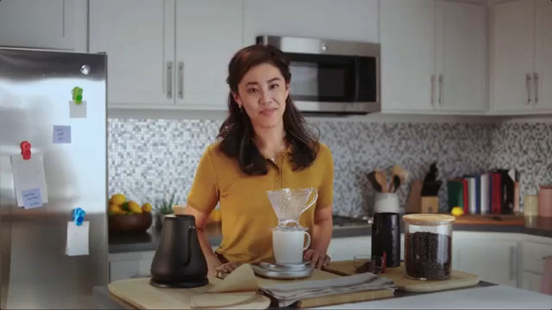



Introduction
Deep Fake Is A Technique For Human Image Synthesis Based On Artificial Intelligence.
Deep Fakes Are Created By Combing And Superimposing Existing Images And Videos Onto Source Images Or Videos Using A Deep Learning Technique Known As Generative Adversarial Network.
4

Slide 6
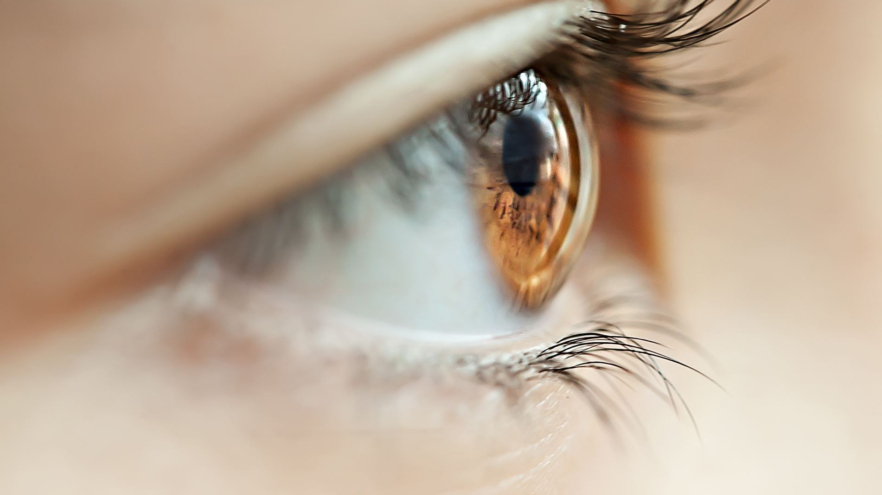
Can We Detect Deep Fakes With Naked Eyes?

Slide 7
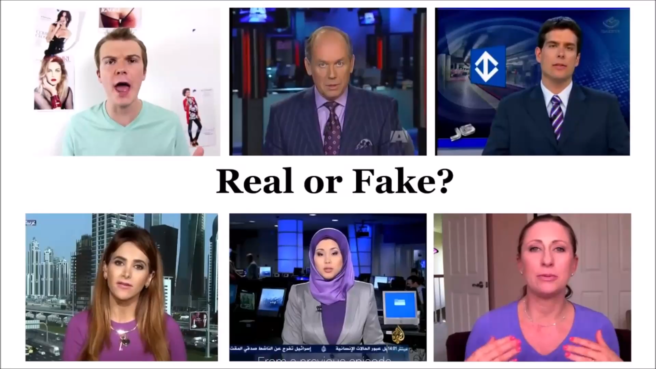
6

Slide 8
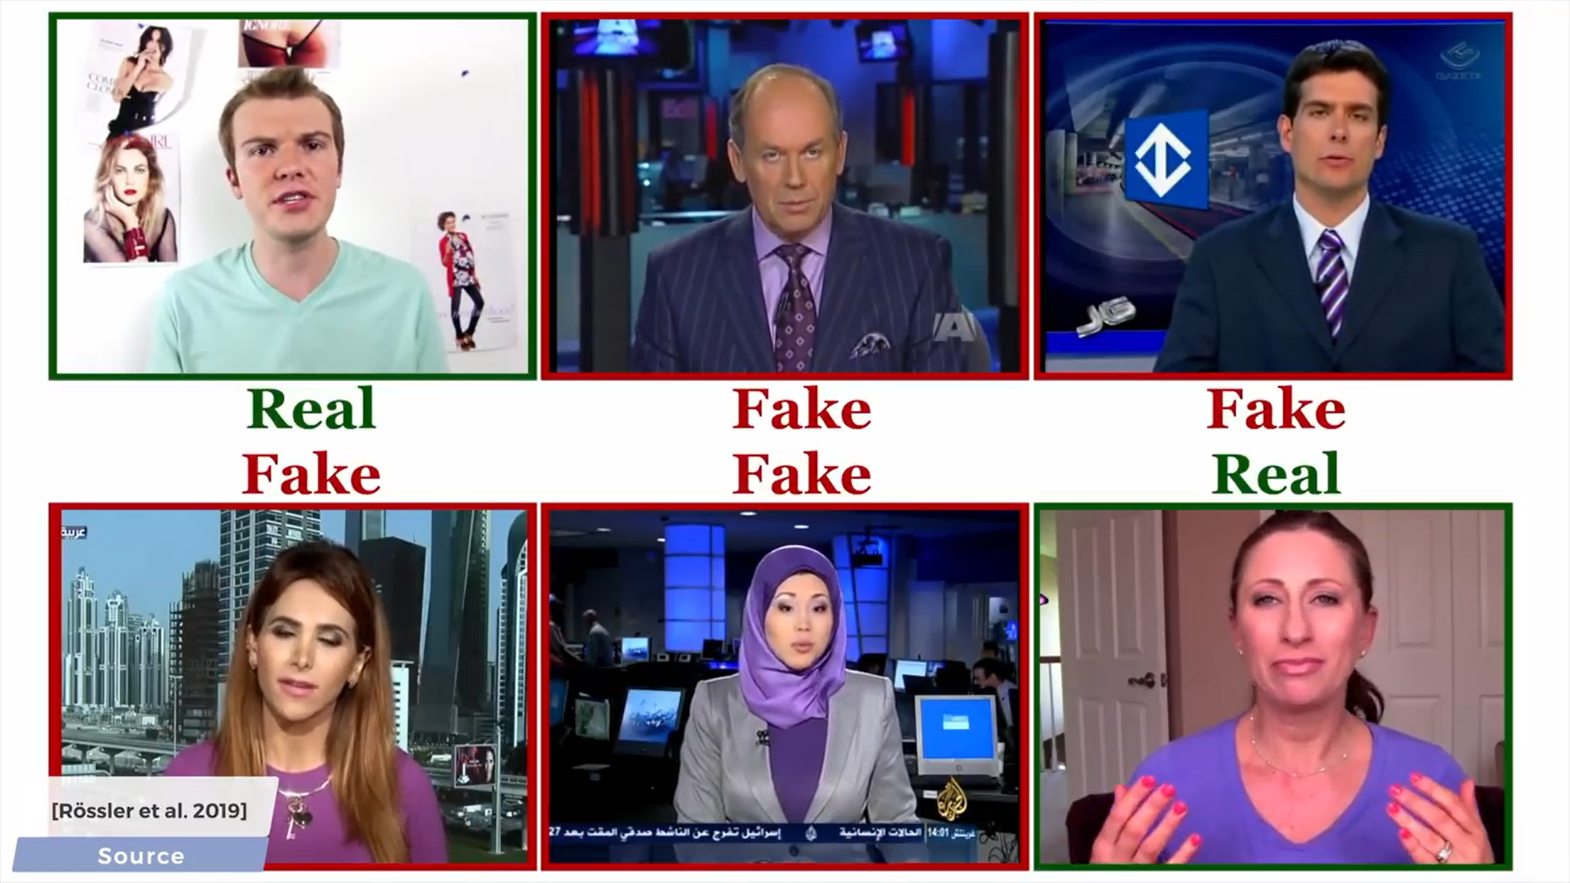
7

Slide 9

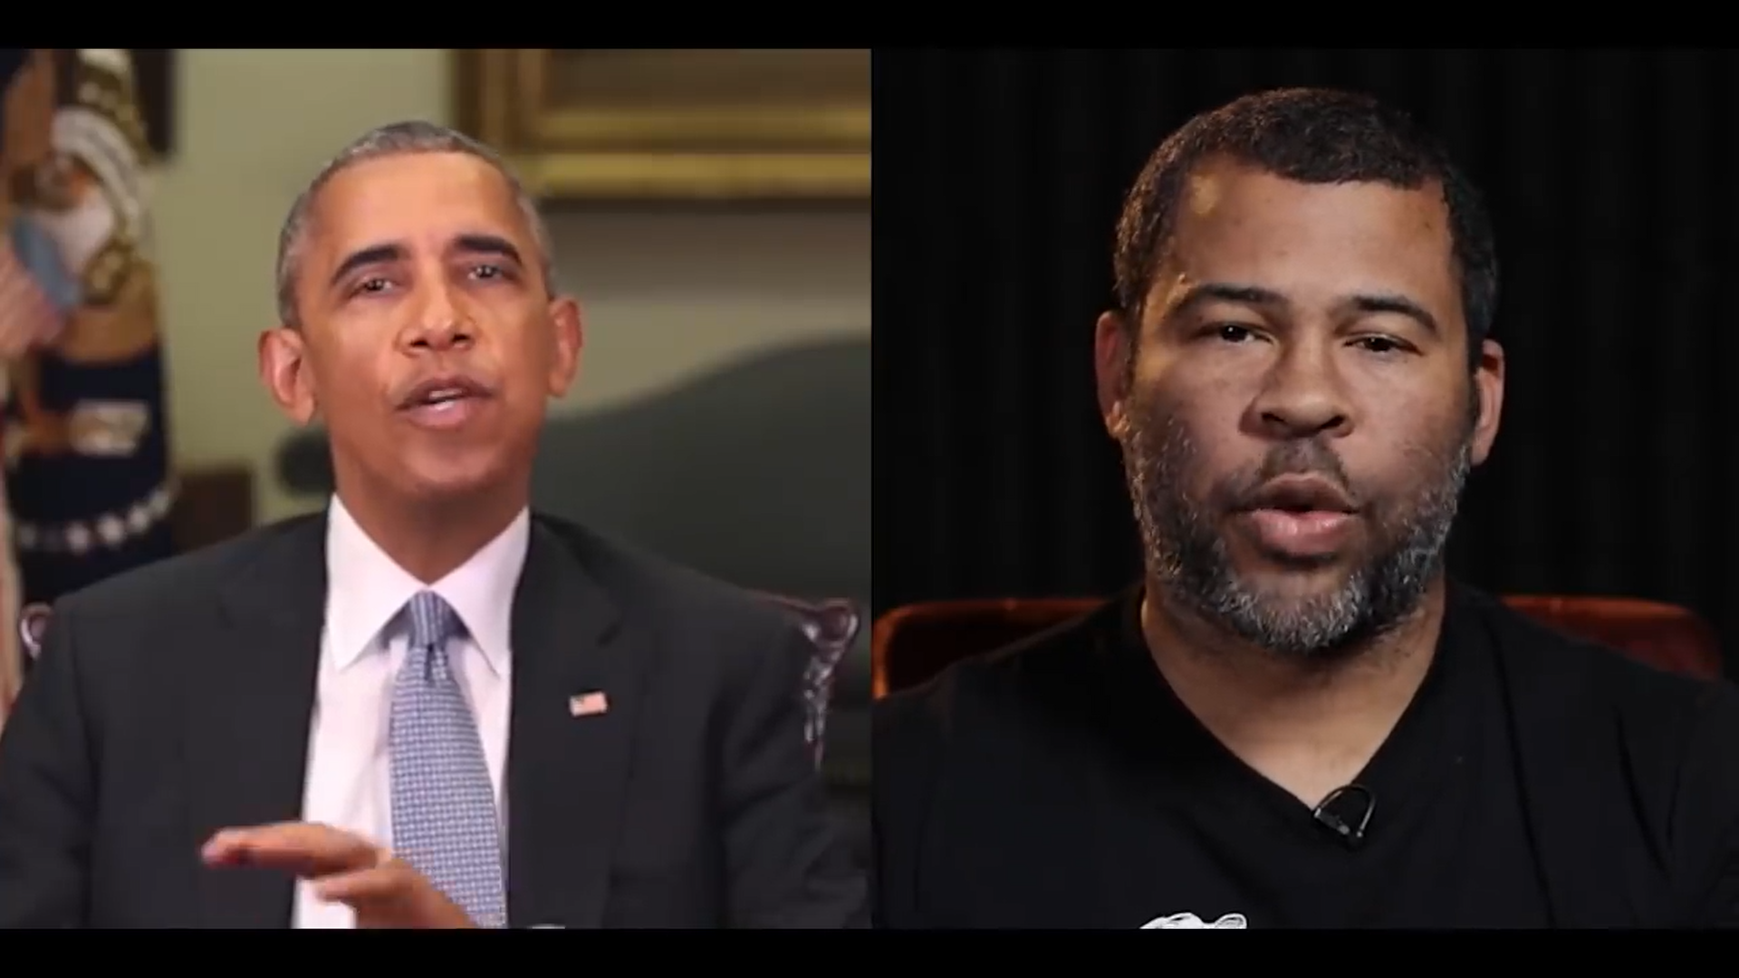


Why Deep Fake Detection ?
Fake News
Malicious hoaxes
Financial fraud
Celebrity unusual video
Revenge Private Videos
Politician videos
8

Slide 10
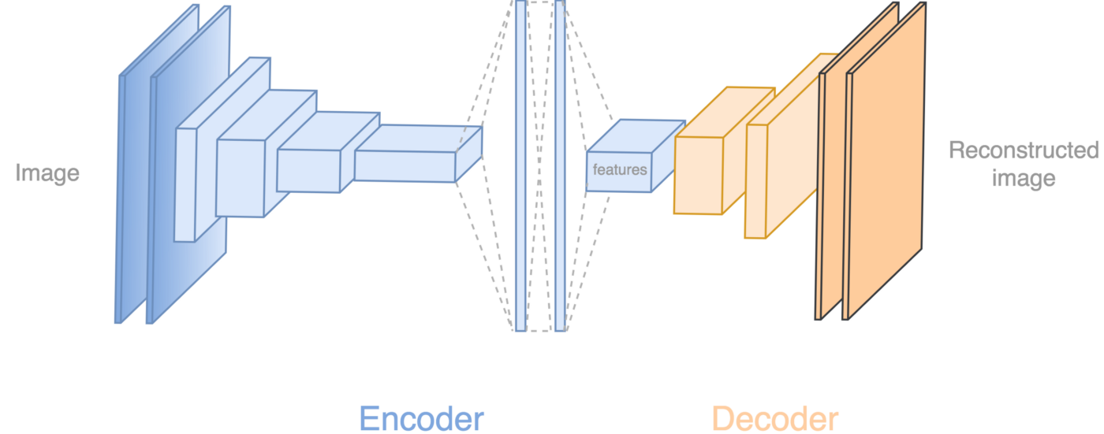
How Deep Fakes Are Created ?
Tools For Deep Fake Creation:-
Faceswap
Faceit
Deepfacelab
Deepfakecapsulegan
Large Resolution Facemasked
9

Slide 11

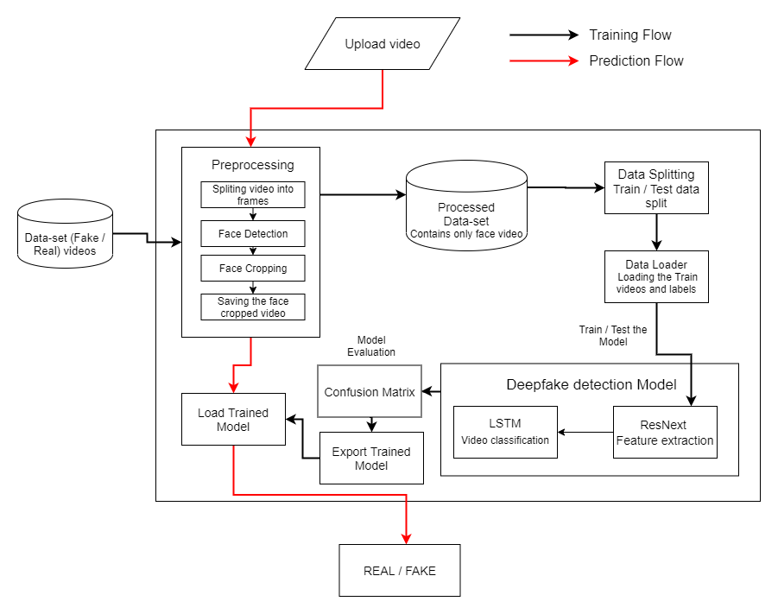
System Architecture
10

Slide 12
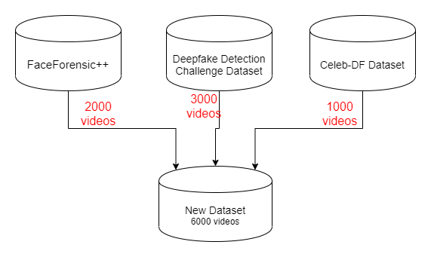
Data-set Exploration
11

Slide 13
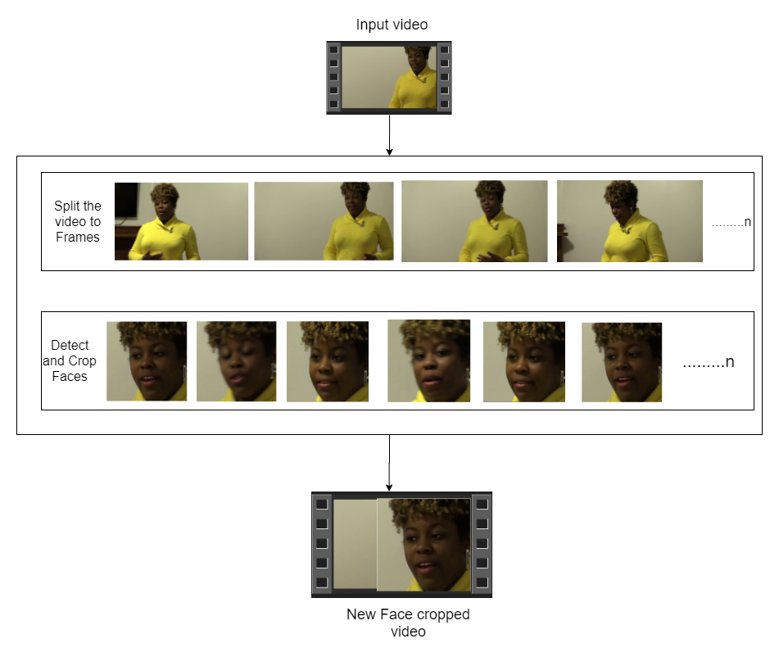

Pre-processing
SPLIT VIDEO INTO FRAMES
FACE DETECTION
5
4
3
2
1
CROPING FACE
CREATING NEW FACE CROPPED VIDEO
SAVING THE FACE CROPPED VIDEO
12

Slide 14
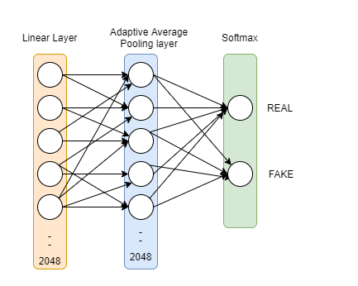
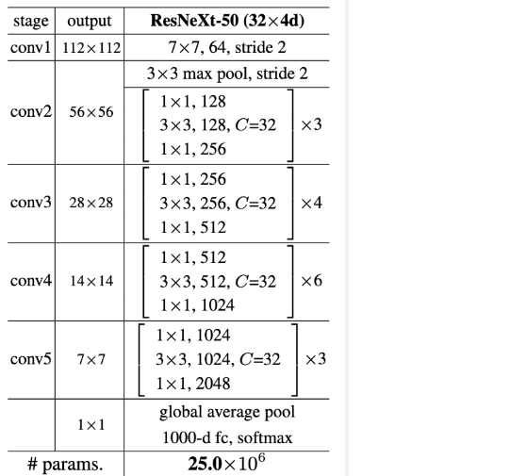

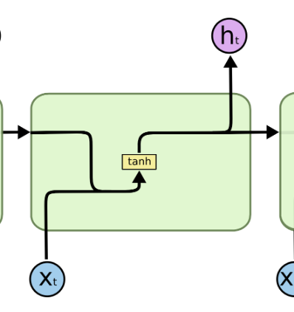
Model Architecture
ResNext-50
Sequential Layer
1 LSTM layer with 2048 shape input vector and 2048 latent features along with 0.4
chance of dropout and ReLU Activation function
13

Slide 15
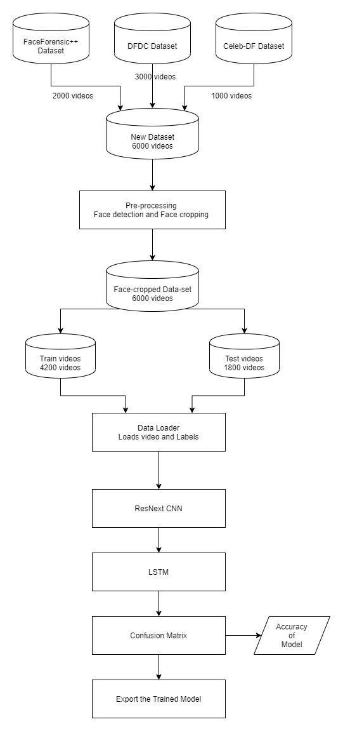
Training
Workflow

Slide 16
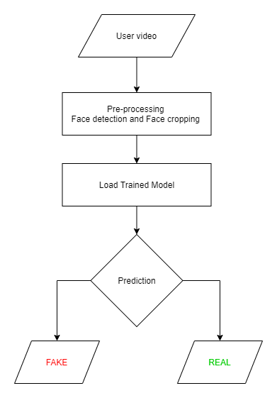
Prediction Workflow

Slide 17














Programming Languages
Python3
JavaScript
Programming Frameworks
PyTorch
Django
Tools and Technologies
IDE
Google
Jupyter Notebook
Visual Studio Code
Cloud Services
Google Cloud Platform
Version Control
Git

Slide 18
Results
Model Name | Dataset | No of Videos | Sequence Length | Accuracy
model_90_acc_20_frames_FF_data | FaceForensic++ | 2000 | 20 | 90.95477387
model_95_acc_40_frames_FF_data |  |  | 40 | 95.22613065
model_97_acc_60_frames_FF_data |  |  | 60 | 97.48743719
model_97_acc_80_frames_FF_data |  |  | 80 | 97.73366834
model_97_acc_100_frames_FF_data |  |  | 100 | 97.76180905
model_84_acc_10_frames_final_data | Our Dataset | 6000 | 10 | 84. 662519
model_87_acc_20_frames_final_data |  |  | 20 | 87.79160186
model_89_acc_40_frames_final_data |  |  | 40 | 89.3468118195956
model_91_acc_60_frames_final_data |  |  | 60 | 91.5909797822706
model_92_acc_80_frames_final_data |  |  | 80 | 92.4981855883877
model_93_acc_100_frames_final_data |  |  | 100 | 92.10883877

Slide 19


